Slide 1

Disaster Damage Identification in Social Media Posts
DATS 6501 – Data Science Capstone
Yuan Meng
Notes:
Hello everyone, my name is Yuan Meng, and my project is about Disaster Damage Identification in Social Media Posts with a CNN model.

Slide 2

Table of Contents
Introduction
Literature Review
Methodology
Results & Analysis
Conclusion
References
Notes:
Here is the structure of my presentation.

Slide 3
1. Introduction-Background
Social media contents
Provide timely and specific information
Assist locate people need help
Notes:
Social media content has become a vital information source for rescuers when major disasters happen. Reports of injured people, infrastructure damage, and missing people on social media provide timely and specific information to help rescue organizations rapidly locate the place or people that need help.

Slide 4
1. Introduction-Problem Statement
The rescue staffing cannot deal with all the dangers immediately when major disasters occur, so it is necessary to grade the situation according to the urgency. This project aims to apply a convolutional neural network model to identify the pictures with disaster types and the degree of urgency to help rescuers arrange rescues reasonably.
Notes:
The rescue staffing cannot deal with all the dangers immediately when major disasters occur, so it is necessary to grade the situation according to the urgency. This project aims to apply a convolutional neural network model to identify the pictures with disaster types and the degree of urgency to help rescuers arrange rescues reasonably.

Slide 5
1. Introduction-Problem Elaboration
How does the model work?
How can the model work for social media posts?
Notes:
The model can be used for social media posted images with disasters tags. And the more serious damage the picture shows, the higher the emergency degree of rescue. The model first identifies the type of disaster and then the urgency (degree of disaster).
#For example, when a city faces a flood, hundreds of rescue messages with flood photos may appear on social media within one minute. However, rescuers cannot go to these locations simultaneously. With this model for urgency classification, rescuers can prioritize those areas that have been severely affected and reduce casualties.

Slide 6
1. Introduction-Motivation
Personal experience
Since 17 July 2021, Zhengzhou China
Maximum rainfall of 201.9 millimetres (7.95 in) in an hour
Water and power outages
Busy helpline
Thousands of help posts on Weibo
Notes:
This summer, the city I lived in was affected by severe flooding due to a long time of heavy rainfall. Almost the whole city suffered water and power outages for a week, and the helplines were busy all the time. There were thousands of help posts on social media such as Weibo, and many of them got resolved. However, manually dealing with those messy contents could be inefficient and unorganized, so I want to construct a project that can automatically collects the relative information and organizes them.

Slide 7
1. Introduction-Project Scope
Result Organization
Tweets Gathering
Image classification
Natural Language Processing
Relevant Tags
Target disaster
Degree of urgency
Key information
Rescue arrangement
Notes:
The ideal project consists of four parts, while due to the time limitation, I only focused on the image classification part.
#The ideal project consists of four parts: first, it automatically gathers target tweets based on related tags; second, it identifies the degree of urgency using image classification; third, it verifies if the post contains enough information such as location and contact details; and at last, it displays the organized results. While due to the time limitation of the work, I only focused on the image classification part.

Slide 8
2. Literature Review
Firoj Alam, Ferda Ofli, and Muhammad Imran, CrisisMMD: Multimodal Twitter Datasets from Natural Disasters. In Proceedings of the 12th International AAAI Conference on Web and Social Media (ICWSM), 2018, Stanford, California, USA.
Hussein Mozannar, Yara Rizk, and Mariette Awad, Damage Identification in Social Media Posts using Multimodal Deep Learning, In Proc. of ISCRAM, May 2018, pp. 529–543.
Ferda Ofli, Firoj Alam, and Muhammad Imran, Analysis of Social Media Data using Multimodal Deep Learning for Disaster Response, In Proceedings of the 17th International Conference on Information Systems for Crisis Response and Management (ISCRAM), 2020, USA.
Notes:
Here are the research I did for my project, and I learned that transfer learning is a useful method for image classification. They worked on some pretrained models and got good results, so I decided to try on these models to find the best one.

Slide 9
3. Methodology-Dataset Description
Disaster types
Other disaster
Earthquake
Fire
Flood
Hurricane
Landslide
Not disaster
Test: 3195
Length
Train: 12846
Validation: 1470
Test: 3865
Damage severity
Little or none
Mild
Severe
Length
Train: 28319
Validation: 2712
Crisis image benchmark dataset
Damage severity
Disaster types
Informativeness
Humanitarian categories
Notes:
The dataset I used for this project is Crisis image benchmark dataset, which has four disaster categories. Disaster types dataset has eight classes, and Damage severity dataset has three classes. All of them are splited into training, validation, and testing sets.

Slide 10

3. Methodology-Dataset Collection
import os
if "crisis_vision_benchmarks" not in os.listdir():
os.system("wget https://crisisnlp.qcri.org/data/crisis_image_datasets_benchmarks/crisis_vision_benchmarks.tar.gz")
os.system("tar xf crisis_vision_benchmarks.tar.gz")
Notes:
The dataset has its official website, so I directly downloaded it using the “wget” method.

Slide 11
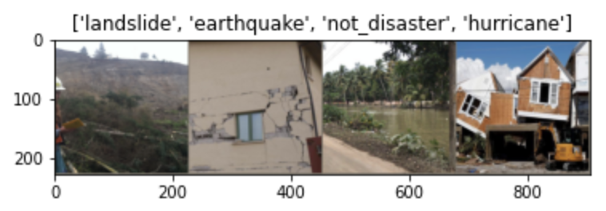
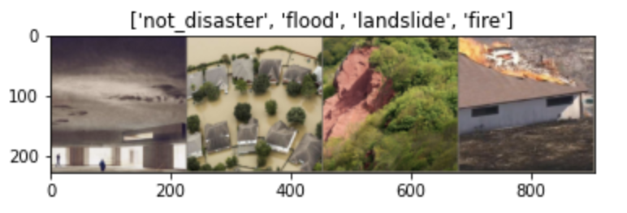
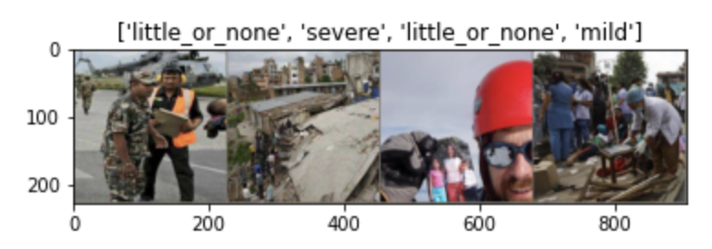
3. Methodology-Data Preprocessing
Custom PyTorch dataset and dataLoader
Shuffle
Data augmentation and normalization for training
Label Encode
PIL Image
Batch Size
Random Resized Crop
Random Horizontal Flip
To Tensor
Normalize
Normalization for validation
Resize
Center Crop
ToTensor
Normalize
Notes:
For data preprocessing, firstly, I built a custom dataset class and data loader using PyTorch to read the image files, encode labels, define the batch size and shuffle them. Second, I deleted the “other disaster” class because it combines various images and could mislead the model. Third, I resized and normalized the image data and converted them to tensors using the transform functions. For the training dataset, I also randomly cropped and randomly flipped images for data augmentation. Here are some sample data after processing.
We can see the obvious building damage or road collapse for the "severe" label, and some broken wood or minor building damage for the "mild" label. And there's almost no damage for the "little or none" label images.

Slide 12
3. Methodology-Data Modeling
Criterion
Optimizer
Learning rate
Cross Entropy Loss
Stochastic gradient descent
Momentum
lr_scheduler
Step size
Gamma
Epoch
Inception v3
Transfer learning
Pre-trained networks
Sufficient training datasets
Reasonable architectures
ResNet 50
VGG 16
Notes:
Pre-trained networks have sufficient training datasets and reasonable architectures, so I decided to use transfer learning method for this project. As introduced in literature review, resnet 50, vgg 16, and inception v3 are suitable for disaster image classification.
I used the CrossEntropyLoss function as the loss function, and the Stochastic gradient descent as the optimizer with 0.9 momenta, the network parameters, and the learning rate. Also, I defined an learning rate scheduler starts at .01, and decays the learning rate by a factor of 0.1 for every 7 epochs.

Slide 13
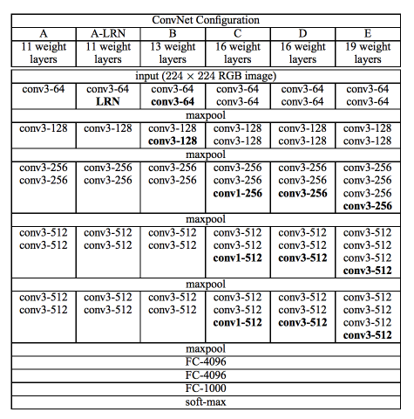
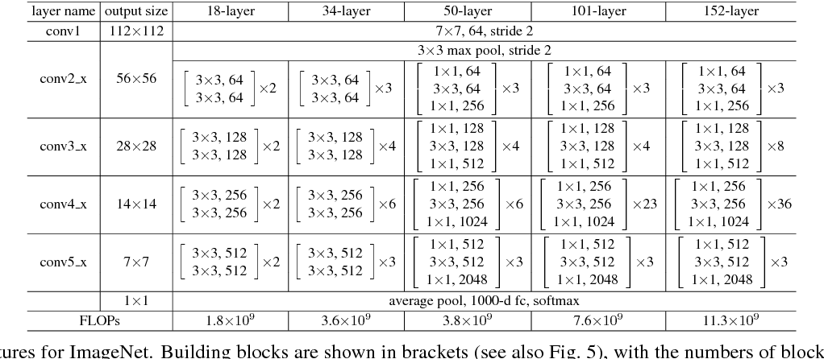
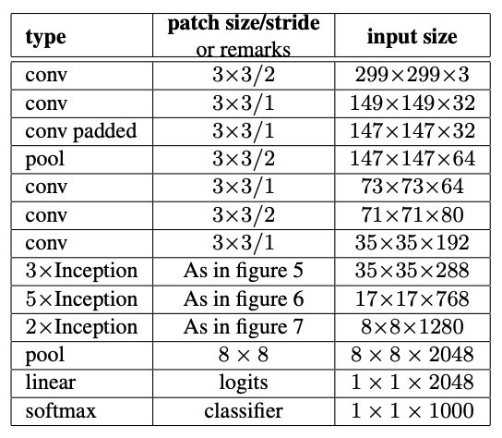
3. Methodology-Mode Visualizations
Figure from Deep Residual Learning for Image Recognition
Figure from Very Deep Convolutional Networks for Large-Scale Image Recognition
Figure from Rethinking the Inception Architecture for Computer Vision
Notes:
Here are the structure of the models I tried. The left one is for resnet 50, the middle one is for vgg 16, and the right one is for inception v3. I loaded these models and modified the size of final linear layer with number labels of the datasets. (classifier): Sequential( (0): Linear(in_features=25088, out_features=4096, bias=True) (1): ReLU(inplace=True) (2): Dropout(p=0.5, inplace=False) (3): Linear(in_features=4096, out_features=4096, bias=True) (4): ReLU(inplace=True) (5): Dropout(p=0.5, inplace=False) (6): Linear(in_features=4096, out_features=1000, bias=True) ) )
model_ft.classifier[6].out_features = len(damage_names)
(avgpool): AdaptiveAvgPool2d(output_size=(1, 1)) (dropout): Dropout(p=0.5, inplace=False) (fc): Linear(in_features=2048, out_features=1000, bias=True) )
(avgpool): AdaptiveAvgPool2d(output_size=(1, 1)) (dropout): Dropout(p=0.5, inplace=False) (fc): Linear(in_features=2048, out_features=7, bias=True)
model_ft.aux_logits=False
num_ftrs = model_ft.fc.in_features
model_ft.fc = nn.Linear(num_ftrs, len(types_names))

Slide 14
3. Methodology-Mode Training
Batch of data
Training set
Forward
Backward
Deviation set
Weights updates
Notes:
For model training, in every epoch, every batch of training and deviation data are loaded to model. It zeros the parameter gradients, computes the running loss and running accuracy. Only for training step the model tracks the forward loss history, and computes the backward loss and optimizes it. Then the model computes the total loss and accuracy for each epoch, and if the accuracy is higher than the record, the best model weights will be updated.
After training and fine tuning the three models numerous times, I got the final results here.

Slide 15
4. Results Comparison
 | Train loss | Train accuracy | Deviation loss | Deviation accuracy | Test accuracy
Disaster type ResNet 50 | 0.4567 | 0.8440 | 0.4486 | 0.8470 | 0.84
Disaster type VGG 16 | 0.4887 | 0.8320 | 0.5214 | 0.8335 | 0.83
Disaster type Inception v3 | 0.4163 | 0.8631 | 0.4503 | 0.8531 | 0.86
Damage severity ResNet 50 | 0.3858 | 0.8503 | 0.6449 | 0.7482 | 0.75
Damage severity VGG 16 | 0.4778 | 0.8097 | 0.6247 | 0.7334 | 0.75
Damage severity Inception v3 | 0.3499 | 0.8644 | 0.6863 | 0.7544 | 0.76

Slide 16
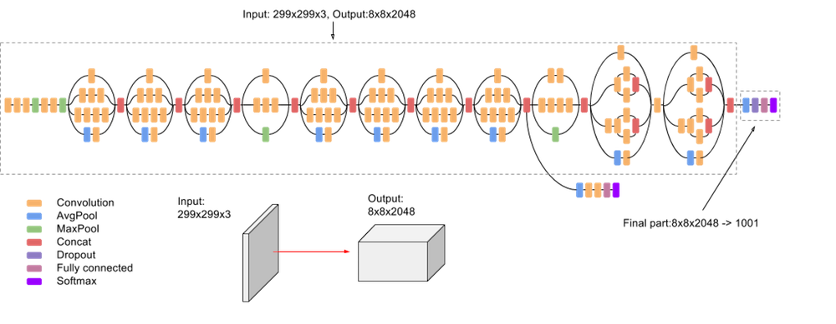
4. Results Analysis-Inception v3
Figure from paperswithcode
Notes:
Inception-v3 is a convolutional neural network architecture which proposed in the paper Rethinking the Inception Architecture for Computer Vision, published in 2015.

Slide 17
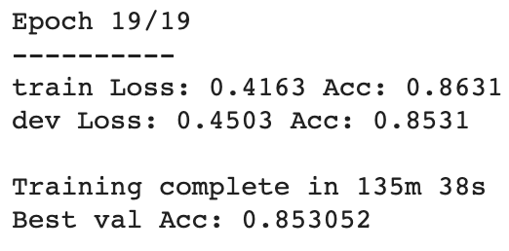
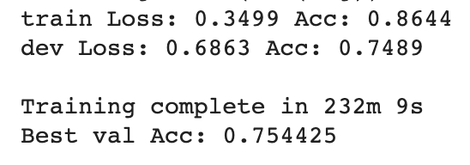
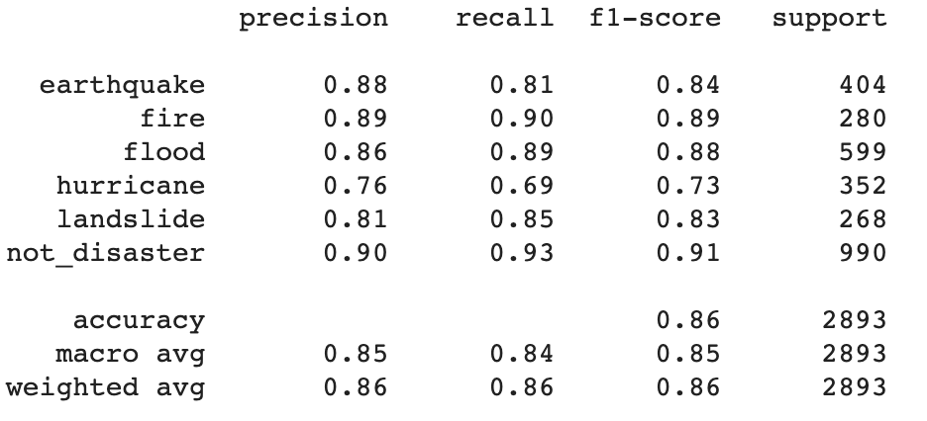
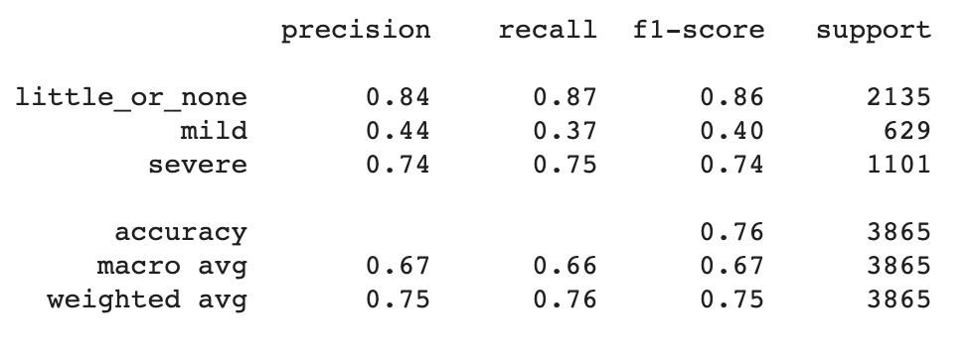
4. Results & Analysis
Notes:
So for the best results, as the graphs show here, I got 0.85 validation accuracy and 0.86 test accuracy for the disaster type data set. The not disaster category has 0.91 f1 score, so the model could mostly identify whether one image representing disasters.
And the damage severity dataset didn't get the results as good as last one. It’s hard for the model to correctly identify the mild damages. It may because I combined different types of disasters together to define the damage severity.

Slide 18
5. Conclusion
Summary
Future research
To identify the social media pictures
To help arrange rescues reasonably
Best applied model: Inception v3
Project limitation
Not selected the specific disaster type
To identify the damage severity
Focus on flood data
MLP-Mixer
Notes:
In conclusion, my project aims to identify the gathered social media pictures with disaster types and the degree of urgency to help rescuers arrange rescues reasonably. I applied the inception v3 model for both disaster type dataset damage severity dataset to classify them and got about 0.85 accuracy.
The limitation of the project is I could not train for the selected disaster type to identify their damage severity, because the data has different images for different tasks, so I could only use the various types of disasters to define the damage severity.
For future research, I’ll collect only one type of disaster image, such as floods, from Twitter and label them by myself to re-train the model to see if there are any improvements. Also, I will work on some other models to improve the results, such as the MLP-Mixer architecture.

Slide 19
References
Henan floods, https://en.wikipedia.org/wiki/2021_Henan_floods
CrisisMMD: Multimodal Twitter Datasets from Natural Disasters，https://arxiv.org/pdf/1805.00713v1.pdf
Damage Identification in Social Media Posts using Multimodal Deep Learning，http://idl.iscram.org/files/husseinmouzannar/2018/2129_HusseinMouzannar_etal2018.pdf
Analysis of Social Media Data using Multimodal Deep Learning for Disaster Response，https://arxiv.org/pdf/2004.11838v1.pdf
Deep Learning Benchmarks and Datasets for Social Media Image Classification for Disaster Response, https://crisisnlp.qcri.org/crisis-image-datasets-asonam20
Deep Residual Learning for Image Recognition, https://arxiv.org/abs/1512.03385
Very Deep Convolutional Networks for Large-Scale Image Recognition, https://arxiv.org/abs/1409.1556
Inception-v3, https://paperswithcode.com/method/inception-v3#
Rethinking the Inception Architecture for Computer Vision, https://www.cv-foundation.org/openaccess/content_cvpr_2016/papers/Szegedy_Rethinking_the_Inception_CVPR_2016_paper.pdf
INCEPTION_V3, https://pytorch.org/hub/pytorch_vision_inception_v3/

